Slide 1
Microsoft
ENTERTAINMENT STUDIOS

Slide 2
Understanding the problem
HUGE REVENUE STREAM
MICROSOFT
RESOURCE ALLOCATION
Over the past decade movie revenues have blown up
Lots of money to be made
Wants to break into the industry
Has the capital
Doesn’t want to be exploring through trial and error
What do we put our money into
Horror Movies?
Leonardo DiCaprio?
Michael Bay?

Slide 3

OUR OBJECTIVE:
Determine which factors best predict a movie’s popularity

Slide 4
Process:
Brainstorm
Search for Data Sources
Collect Data
Exploratory Data Analysis
Clean Data
Hypothesize
Build visualizations

Slide 5
Draw conclusions
Ultimately
Do certain genres generate a greater profit margin?
Will movies starring a particular actor be more popular than without?
Are there any directors that produce higher quality movies?

Slide 6



Brainstorm, Search for Resources, Collect
Mehmet
Genre : Budget/Box Office revenue
Webscrape and API
Dave
Critic reviews based on director
Webscrape
Sam
User reviews Based on actors
Webscrape and API

Slide 7
Data cleaning and Results
MySQL to focus on certain groups of data that we identified in our hypothesis
Pandas to clean and organize data into dataframes
PYPLOT to graph visualizations and help us get an idea of what the data was telling us

Slide 8
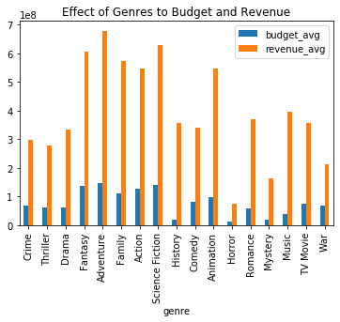
How much of the money generated was profit
Why would mystery and music genres show a greater profit margin?
Why would war movies have such a low profit margin?
History outlier

Slide 9
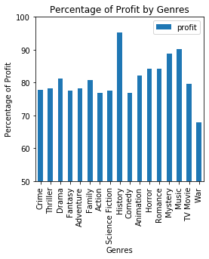
PROFIT MARGIN
divided by genre
History outlier

Slide 10
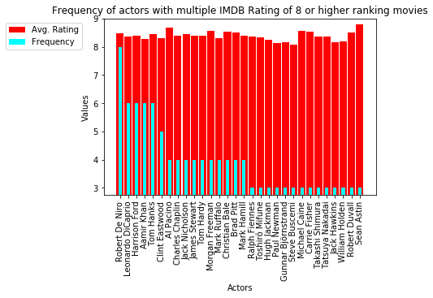
Actors who consistently star in well-received movies

Slide 11
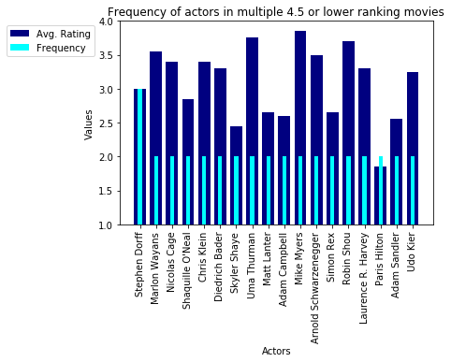
Actors who consistently star in poorly-received movies

Slide 12
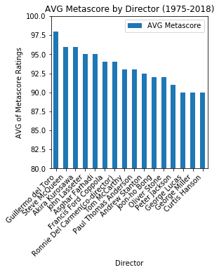
Which directors consistently make great movies?

Slide 13
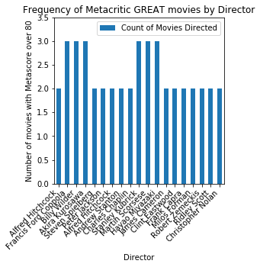
Repeat offenders

Slide 14
In conclusion:
Lower cost-of-production (genres)
Robert DiNero
Most frequent highest rated actor
Not Stephen Dorff
Most frequent lowest rated actor
Martin Scorcese

